Slide 1
Particle Theory of Matter
An Introduction to Chemistry

Slide 2
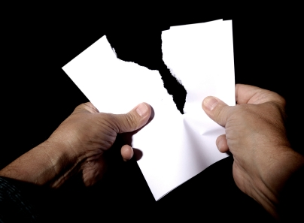
A simple Question
Rip a piece of paper in half
Keep ripping it into smaller and smaller pieces
Can you keep on ripping it forever?
The ancient Philosophers thought about this simple question for all the different types of matter (stuff) on Earth.

Slide 3
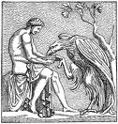
What Is Matter
The Ancient Philosophers knew…
Matter has mass
Matter takes up space
They used logic to hypothesize that…
All matter is made up of microscopic particles
Each pure substance has its own smallest unique type of particle
If you split these smallest particles then you would end up with something different

Slide 4
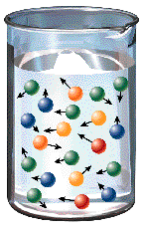
Today We Know
The Ancient Philosophers were right!
All matter is made up of microscopic particles
Each pure substance has its own unique type of particle
In Addition we know…
The particles are always moving!
Particles are moving slowly in a solid. (e.g. Ice)
Particles are moving more quickly in a liquid. (e.g. Water)
Temperature is a measure of how fast particles are moving!

Slide 5
Particle Theory of Matter
All matter is made of extremely tiny particles
All pure substances are made of their own kind of particle
All particles are moving.
Particles at higher temperatures move faster than those at lower temperatures.
Particles are attracted to each other.

Slide 6
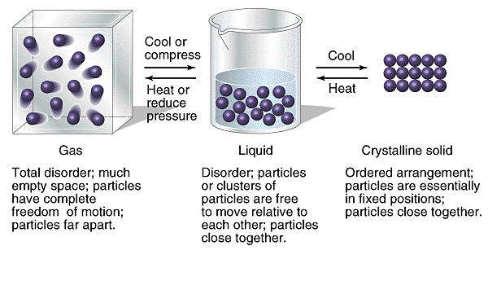
Three States of Matter
Under normal conditions, matter is found in one of three states:
Solid – Particles are close together
Liquid – Particles are farther apart
Gas – Particles are very far apart
The particles are the same in each state!
They are just moving differently
They just have a different temperature

Slide 7
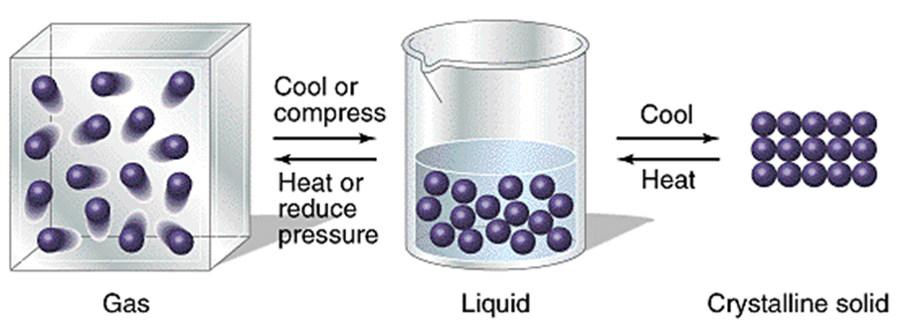
States of Matter
Water Vapor
Water articles are moving very fast
Particles are far apart
and weakly attracted
Water
Water particles are moving slowly
Particles are closely spaced and strongly attracted
Ice
Water particles are moving very slowly
Particles are locked into place and are very strongly attracted

Slide 8
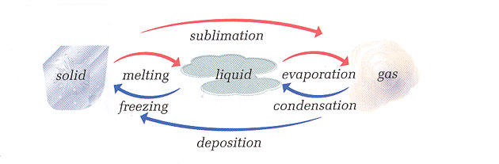
Changes of State

Slide 10
States of Matter

Slide 11
Changes of State

